Slide 1
CAR SEGMENTATION
Progress Report & First Results
Author:
Piter Garcia

Slide 2
First Steps
Edge Detection
Extracting Edges
Shape Extraction
Texture Extraction
Separate Image

Slide 3
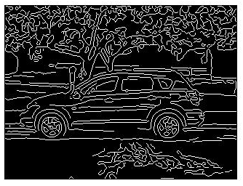
Edge Detection
Edge detection is a fundamental concept for segmentation. This is easy not only to understand its principle but also to implement.

Slide 4
Method:
im = imread('Auto2.jpg');
%figure, imshow(im);
figure,
im2= im2double(im);
subplot(2, 2, 1),imshow(im2); title('Iam2Double');
im3= rgb2gray(im2);
subplot(2, 2, 2),imshow(im3); title('Rgb2Gray');
im4= imresize(im3, [167 250]);
subplot(2, 2, 3),imshow(im4); title('Rgb-Resized');
im5=edge(im4,'canny',[],0.5);
subplot(2, 2, 4),imshow(im5); title('Gamma = 0.5');
suptitle('Transforming Image to Find Edges');

Slide 5
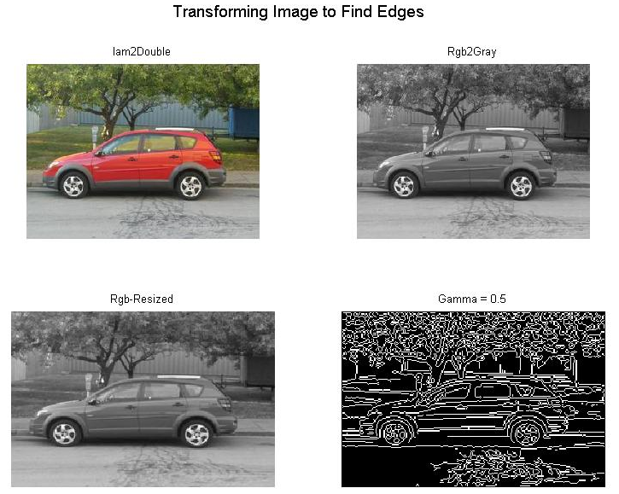
Output Image - Transition

Slide 6
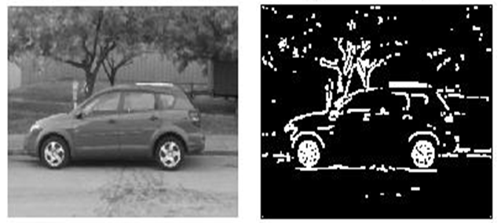
Extracting Edges
im1=medfilt2(im1,[3 3]);
BW = edge(im1,'sobel');
[imx,imy]=size(BW);
msk=[0 0 0 0 0; 0 1 1 1 0; 0 1 1 1 0; 0 1 1 1 0; 0 0 0 0 0;];
B=conv2(double(BW),double(msk));
L = bwlabel(B,8);
mx=max(max(L))
[r,c] = find(L==17);
rc = [r c];
[sx sy]=size(rc);
n1=zeros(imx,imy);
for i=1:sx
x1=rc(i,1);
y1=rc(i,2);
n1(x1,y1)=255;
end
figure,imshow(im);

Slide 7
Shape Extraction
figure,
I_eq = adapthisteq(I_eq);
subplot(2, 2, 1), imshow(I_eq)
bw = im2bw(I_eq, graythresh(I_eq));
subplot(2, 2, 2), imshow(bw)
bw2 = imfill(bw,'holes');
bw3 = imopen(bw2, ones(5,5));
bw4 = bwareaopen(bw3, 40);
bw4_perim = bwperim(bw4);
subplot(2, 2, 3), imshow(bw4_perim)
mask_em = imextendedmax(I_eq, 30);
subplot(2, 2, 4),imshow(mask_em)

Slide 8
OutPut Image - Comparison
figure,
mask_em = imclose(mask_em, ones(5,5));subplot(2, 2, 1), imshow(mask_em)
mask_em = imfill(mask_em, 'holes');subplot(2, 2, 2),imshow(mask_em)
mask_em = bwareaopen(mask_em, 40);subplot(2, 2, 3),imshow(mask_em)
figure,
I_eq_c = imcomplement(I_eq);
subplot(2, 2, 4),imshow(I_eq_c)
I_mod = imimposemin(I_eq_c, ~bw4 | mask_em);
subplot(1, 2, 1),imshow(I_mod )
L = watershed(I_mod);
subplot(1, 2, 2),
imshow(label2rgb(L))

Slide 9
Texture Extraction
I=imread('Auto2.jpg');
figure,imshow(I)
hy = fspecial('sobel');
hx = hy';
Iy = imfilter(double(I), hy, 'replicate');
Ix = imfilter(double(I), hx, 'replicate');
gradmag = sqrt(Ix.^2 + Iy.^2);
figure, imshow(gradmag,[]),
L = watershed(gradmag);
figure, imshow(L)
se = strel('disk', 20);
Io = imopen(I, se);
figure, imshow(Io), title('Opening (Io)')
Ie = imerode(I, se);
Iobr = imreconstruct(Ie, I);
figure, imshow(Iobr)

Slide 10
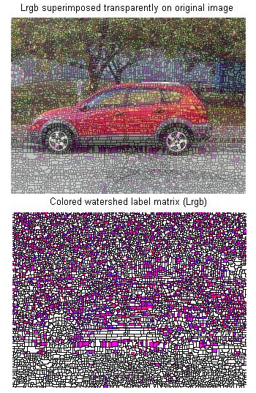
Texture Extraction
Ioc = imclose(Io, se);
figure, imshow(Ioc)
Iobrd = imdilate(Iobr, se);
Iobrcbr = imreconstruct(imcomplement(Iobrd), imcomplement(Iobr));
Iobrcbr = imcomplement(Iobrcbr);
figure, imshow(Iobrcbr)
fgm = imregionalmax(Iobrcbr);
I2 = I;
I2(fgm) = 255;
figure, imshow(I2)
se2 = strel(ones(5,5));
fgm2 = imclose(fgm, se2);
fgm3 = imerode(fgm2, se2);
fgm4 = bwareaopen(fgm3, 20);
I3 = I;
I3(fgm4) = 255;
figure, imshow(I3)

Slide 11
Texture Extraction
bw = im2bw(Iobrcbr, graythresh(Iobrcbr));
figure, imshow(bw)
D = bwdist(bw);
DL = watershed(D);
bgm = DL == 0;
figure, imshow(bgm)
L = watershed(gradmag);
I4 = I;
figure, imshow(I4)
figure, imshow(L)
figure, imshow(I), hold on
himage = imshow(L);
set(himage, 'AlphaData', 0.3);

Slide 12
Separate Image
a=imread('Auto2.jpg');
b1 = im2double(a);
b = rgb2gray(a);
b1=10*round(b/10);
figure,imhist(b);
figure,imhist(b1);
figure,
a2=255*((a>=0)&(a<=14));
subplot(2, 2, 1),imshow(a2);
a3=255*((a>=15)&(a<=15));
subplot(2, 2, 2), imshow(a3);
figure,
a4=255*((a>=16)&(a<=99));
subplot(2, 2, 1), imshow(a4);
a5=255*((a>=100)&(a<=149));
subplot(2, 2, 2), imshow(a5);
a6=255*((a>=150)&(a<=220));subplot(2, 2, 3), imshow(a6);
a7=255*((a>=221)&(a<=255));subplot(2, 2, 4), imshow(a7);

Slide 13
Separate Image
figure,
b2=255*((b>=0)&(b<=14));
subplot(2, 2, 1), imshow(b2);
b3=255*((b>=15)&(b<=15));
subplot(2, 2, 2), imshow(b3);
figure,
b4=255*((b>=16)&(b<=99));
subplot(2, 2, 1), imshow(b4);
b5=255*((b>=100)&(b<=149));
subplot(2, 2, 2), imshow(b5);
b6=255*((b>=150)&(b<=220));
subplot(2, 2, 3), imshow(b6);
b7=255*((b>=221)&(b<=255));
subplot(2, 2, 4),imshow(b7);

Slide 14
Background Extracted

